Slide 1
PPSR 10 Years on
Jo-Anne Fitchett

Slide 2
Introduction
Personal Property Securities Act 2009 (Cth) (‘PPSA’) – Commonwealth Legislation governing the creation, priority and enforcement of security interest.
On 30 January 2012 the definition of a “security interest” was expanded to include securities such as:
Mortgage Charges and Pledges;
Finance Leases;
Hire Purchase; and
Long-term Leases.

Slide 3
2015 Review
A Statutory review of the PPSA was conducted in 2015;
The following legislative changes were introduced:
The amended definition of the PPS lease on 1 October 2015 and 20 May 2017; and
The amended definition of motor vehicle on 1 July 2014.

Slide 4
The Definition of PPS Lease
Minimum Duration (for either a PPS Lease or Bailement) was extended from 1 year to 2 or more years.
After 20 May 2017
A PPS Lease is a lease or bailment where the agreement to lease or bail the property is for:
A set term, of more than two years including options to renew; or
An indefinite period but not until the lessee’s or bailee’s possession extends for more than two years.
Leases of an indefinite term will not be considered as a PPS Lease unless and until they run for a period of greater than two years.
This does not affect agreements entered into prior 20 May 2017.

Slide 5
The Definition of PPS Lease - EXAMPLE
A Machine is leased for an indefinite term under a lease agreement and is returned after 21 months the machine, then this lease would not be considered a PPS Lease and will not be subject to the relevant provisions of the Personal Property and Securities Act 2009 (Cth).
However, if the machine is returned after 34 months (as it is greater than 2 years), the machine will be considered the subject of a PPS Lease, and would be subject to the relevant provisions of the Personal Property and Securities Act 2009 (Cth).

Slide 6
Section 13 – Personal Property and Securities Act 2009 (Cth)
Meaning of PPS lease
(1) A PPS lease means a lease or bailment of goods:
(a) for a term of more than 2 years ; or
(c) for a term of up to 2 years that is automatically renewable, or that is renewable at the option of one of the parties, for one or more terms if the total of all the terms might exceed 2 years; or
(d) for a term of up to 2 years, or a lease for an indefinite term, in a case in which the lessee or bailee, with the consent of the lessor or bailor, retains uninterrupted (or substantially uninterrupted) possession of the leased or bailed property for a period of more than 2 years after the day the lessee or bailee first acquired possession of the property (but not until the lessee's or bailee's possession extends for more than 2 years).
(2) However, a PPS lease does not include:
(a) a lease by a lessor who is not regularly engaged in the business of leasing goods; or
(b) a bailment by a bailor who is not regularly engaged in the business of bailing goods; or
(c) a lease of consumer property as part of a lease of land where the use of the property is incidental to the use and enjoyment of the land; or
(d) a lease or bailment of personal property prescribed by the regulations for the purposes of this definition, regardless of the length of the term of the lease or bailment.
Bailments for value only
(3) This section only applies to a bailment for which the bailee provides value.

Slide 7
Registration of a PPS Lease for an indefinite term
The PPS Lease for an indefinite term may be registered at the time the lessor has reasonable grounds to believe that the indefinite term will exceed a two year period.
However, to obtain Payment Monies Security Interests (PMSI) priority there is a strict time frame for registration. In the cases of an indefinite term, the possession will be had for an extended prior before it is apparent the two year period would be exceeded.

Slide 8
Samwise Holdings Pty Ltd v Allied Distribution Finance Pty Ltd [2018] SASCFC 95
Material Facts:
Samwise Pty Ltd provided finance to Bills Motorcycles.
Bills Motorcycles held motorbikes on bailment for Commercial Distribution Finance Pty Ltd (‘CDF’).
Bills motorcycles went into administration and Allied Distribution Finance sought a declaration that the PMSI held by Allied Distribution has priority over the AllPAAP security interest to Samwise.
Note: Bills Motorcycles held simple possession of the motorbikes since they were bailed by CDP.
Key Findings
The decision related to whether the PMSI received the super priority as it was ‘perfected by registration’ at the time the Grantor obtains possession of the inventory.
The Court held it was possession as the grantor of the PMSI and as such Allied Distributions has priority as the security was registered at the time Bill Motorcycles became the bailee of Allied Distributions.

Slide 9
StockCo Agricaptial v Dairy Livestock Services Pty Ltd [2020] NSWSC 318.
Material Facts
Reid Agriculture (‘Reid’) had a credit account with stock and station agent, Dairy Livestock Services Pty Ltd (‘DLS’).
StockCo registered a PMSI registration to fund cattle purchase.
DLS acted as agent and charged their standard fee (Purchase Agent fee) for buying the cattle.
StockCo provided the following finance documents:
All stock acquired by the customer as agent for StockCo;
StockCo had a security interest over any acquired stock and products derived from the stock and proceeds; and
StockCo took a General Security Agreement over any other stock of the customer and perfected it by a PMSI and non PMSI lodged after DLS security interest.
DLS sold the stock for Reid and the question was who was entitled to the proceeds.

Slide 10
StockCo Agricaptial v Dairy Livestock Services Pty Ltd [2020] NSWSC 318.
Court Held:
StockCo had a perfected PMSI registration over the cattle despite the fact that Reid as purchaser had already taken possession of the stock before the StockCo Facility and the PMSI registered in Place.
Section 62(2)(b)(i) of the PPS Act is possession as the Grantor of the security not possession in any other capacity.
StockCo PMSI had priority over the DLS non-PMSI security interest.

Slide 11
Prior to 20 May 2017
A PPS Lease entered into prior to 20 May 2017 is a lease or bailment where the agreement to lease or bail the property is for:
A set term of more than one year including options to renew.
An Indefinite period.
A term of up to one year or an indefinite term where the consent of the lessor or bailor, the lessee or bailee continues to retain substantially uninterrupted possession of the property.

Slide 12
Prior to 20 May 2017 – Leases of Serial Numbered Goods
The rule for PPS Leases of Serial Numered goods such as motor vehicles aircrafts and watercrafts changed from 1 October 2015:
A Lease or Bailment of serial numbered goods entered into:
On or after 30 May 2017 are a PPS Lease if they have a fixed term of two or more years.
On or after 1 October 2015 but before 20 May 2017 if they have a fixed term of 90 days and one year.
Before 1 October 2015 if they have a fixed term of 90 days or more.

Slide 13
Definition of Motor Vehicle
Definition of Motor Vehicle was narrowed from 1 July 2014 due to the impact on the small to medium hire businesses.
The definition includes cars, vans,utes, trucks, motorbikes, cares and motorbikes.
New Definition – Property is a motor vehicle if it is built to be propelled wholly on land by a motor that forms part of it (but not if it runs on rails, tram lines or other fixed paths) and has a unique serial number and:
Up to end 30 June 2014 – is capable of travelling at more than 10km or has a total motor power greater than 200W.
Starting on 1 July 2014 – is capable of travelling at more than 10km and has a total motor power greater than 200W.

Slide 14
What’s this mean?
Property such as elevating work platforms, asphalt pavers, dozers, pipeliners and motorized shovels depending on their maximum speed and power may no longer fall under the ‘motor vehicle’ definition for the purposes of the PPSA.
If this registration was effected prior to 1 July 2014, you may need to consider updating the registration over ‘other goods’ rather than ‘motor vehicle’.

Slide 15
ASIC v Carey[2015] FCA 144
Considered the definition of motor vehicles and said it included: cars, trucks, buses, motorcycles and other motor vehicles designed for use on roads and highways.
It does not include vehicles not designed to be propelled by a motor for example a bicycles, wheelchair or non-motorised scoots.

Slide 16
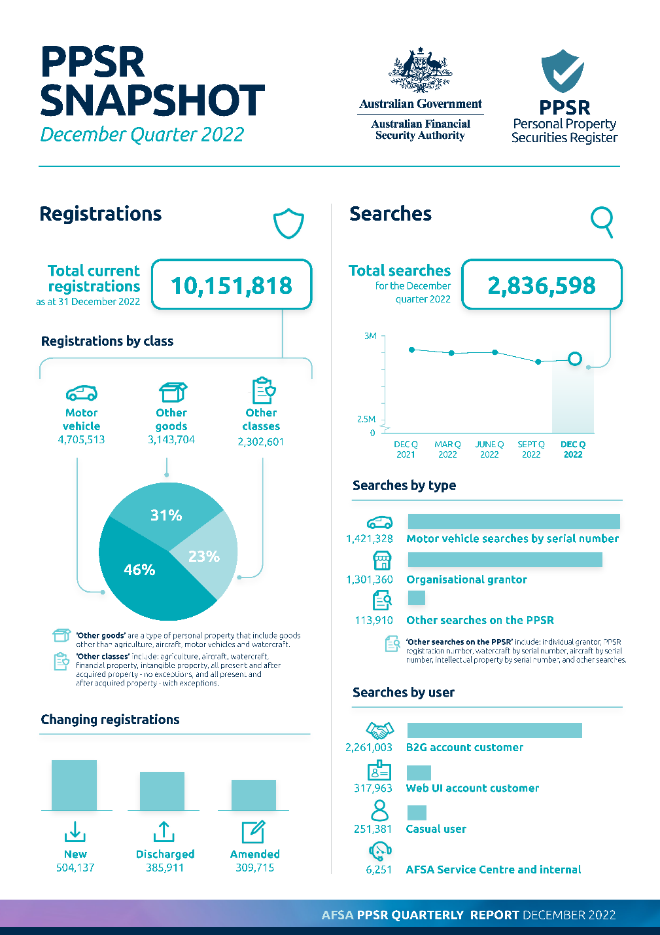
CURRENT STATISTICS

Slide 17
List of Relevant Cases of Interest
Keon Pty Lty as trustee for Keon Family Trust v Holdfields Equipment Pty Ltd (in Liquidation) [2020] WASX 61 – deals with Loan agreement but no security agreement.
Dalian Huarui Heavy Industry International Company Pty Ltd v Clyde & Co Australia [2020} WASC 132 – Deals with funds held in trust
Evolution Fleet Services Pty Ltd v Allroads Plant Pty Ltd [2020] FCA 1084 – Extension of Time – Corporations Act
One Steel Manufacturing Pty Ltd – ACN v ABN
Walsh v KC & WL Brain [2023] NSWDC 38 – deals with a security interest over Rice - rice was considered be a fixture and not a chattel
Froge Group Power Pty Limited v General Electric International Inc [2016] NSWSC 52 – turbines were considered to be a chattel
Golden Valley Iron Pty ltd (in liquidation) v OPS Screening & Crushing Equipment Pty Ltd [2022] WASCA 134 – equipment lease with an option to purchase clause is a security interest and needs to be registered by the owner.

Slide 18
Practical Tips
Migrated security interests: AllPAAP security interest but if you look at the attached document you will see it is a fixed charge.
Proceeds: AllPAAP is only the proceeds, not the collateral.

Slide 19
Case Study
Farmer Smith has an unencumbered cane farm and wishes to sell the Farmer Brown
Farmer Brown only had part of the Purchase Price in cash and is not able to obtain a loan of the funds for the balance of the Purchase Price from the Bank.
Farmer Brown offers to Farmer Smith to purchase the cane farm and the crop with Vendor Finance for the balance of the Purchase Price.
What is your advice to Farmer Smith, Consider what documents are required:
Loan Agreement;
Mortgage over the land;
Security over all of the assets of the Buyer (General Security Agreement)
Security over the crop or Mortgage
Does the Buyer already have a General Security Agreement to his Bank or other supplier of Goods
Is a Priority Agreement required.

Slide 20
CONTACT DETAILS
Jo-Anne Fitchett – Consultant
Phone: 07 4771 5664
Email: jo-anne.fitchett@cosu.com.au

